Slide 1
Human Cannonball
By
Zach Sins
Simeon Nordlander

Slide 2
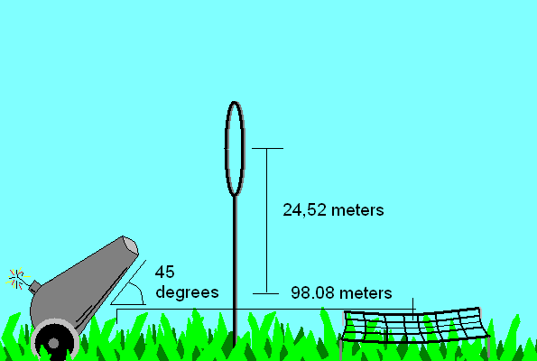
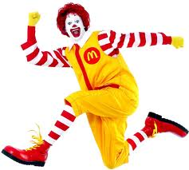

Slide 3
Initial Y Velocity
Angle 45 degrees
V_{i} = 31 m/s
A = -9.8 m/s
V_{i,y} = (31 m/s)*sin(45)
V_{i,y} = 21.9203 m/s

Slide 4
Time
V_{peak} = V_{i,y} + at_{peak}
0 = 21.9203 m/s + (-9.8 m/s²)t
-21.9203 = (-9.8 m/s²)t
2.2367 = t_{peak}
t_{total} = 4.4734

Slide 5
Range
V_{x} = (31 m/s)*cos(45)
V_{x} = dx/dt
21.9203 m/s = dx/4.4734s
98.0823 m = dx
The safety net should be placed 98.0823 meters from the cannon

Slide 6
Height
V_{peak}² = V_{i,y}² + 2*a*dy
0 = (21.9203 m/s)² + 2(-9.8 m/s)*dy
-480.4996 = -19.6*dy
24.5153 m = dy
The hoop should be 24.5153 meters above the ground

